Slide 1
A hands-on approach on botnets for a learning purpose
Computer Systems Security

Slide 2
Agenda
Botnet anatomy
History
Countermeasures
Botnet Wiki
Botnet Lab
Demo

Slide 3
Anatomy of a botnet
What is a botnet?
“A botnet is a number of Internet-connected computers communicating with other similar machines in an effort to complete repetitive tasks and objectives.”
In Wikipedia

Slide 4
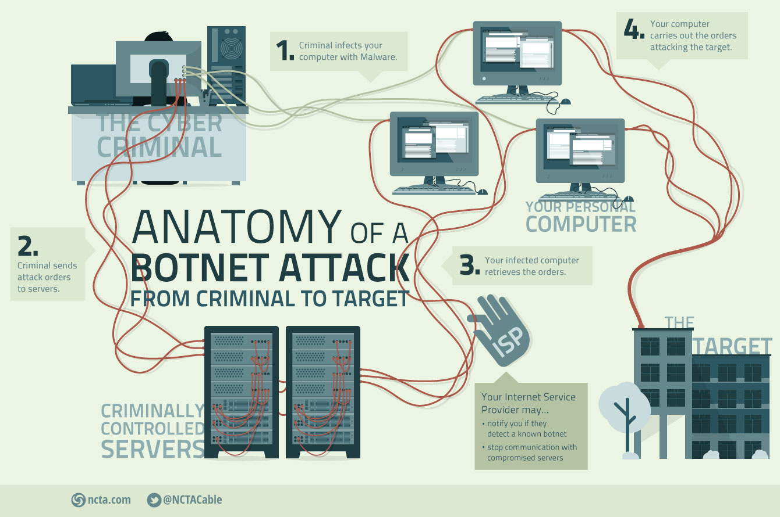

Slide 5
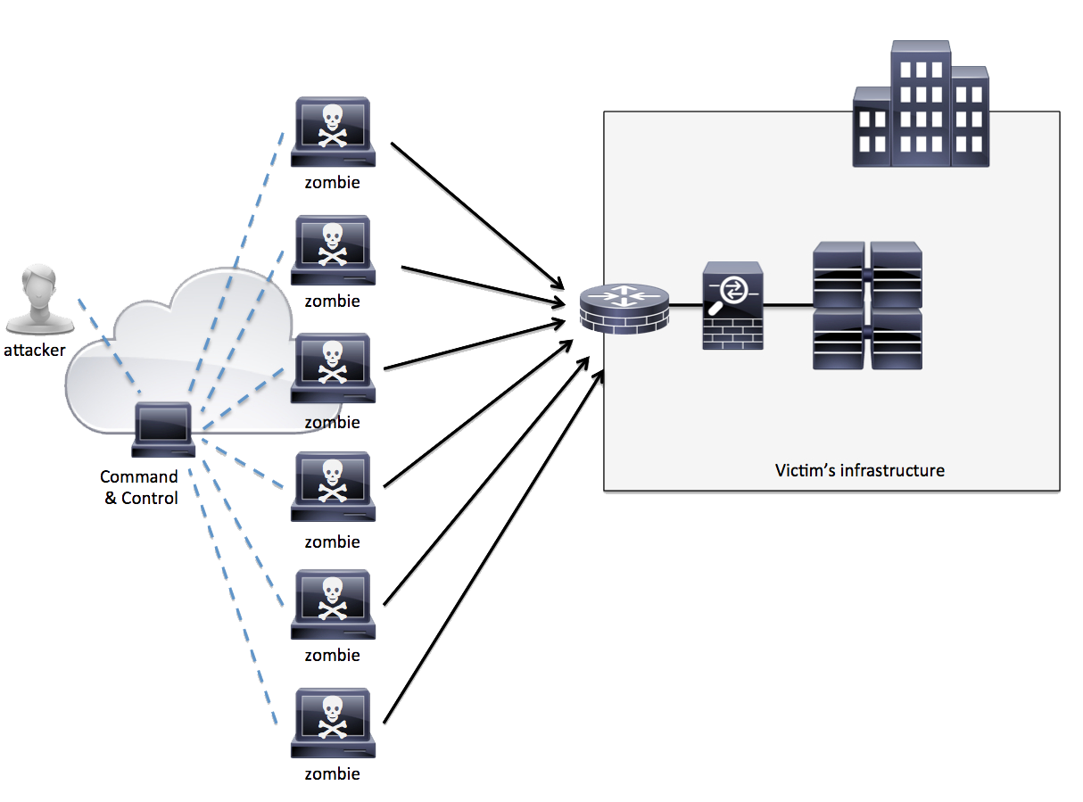
Botnet organization

Slide 6
Type of bots
Agobot
There are more than 500 known different versions of Agobot and this number is increasing. The bot itself is written in C++ .
SDBot
SDBot is written in very poor C. It is the father of RBot, RxBot, UrBot, UrXBot, JrBot,...
mIRC-based Bots (GT-Bots)
These bots launch an instance of the mIRC chat-client with a set of scripts and other binaries.

Slide 7
Types of attacks
DDoS
Spamming
Sniffing Traffic
Keylogging

Slide 8
Types of attacks
Bot
Spreading new Malware
Installing Advertisement Addons
Google AdSense abuse
Attack IRC Chat Networks
Manipulating online polls and games
Mass identity theft

Slide 9
History of botnets
2004
Bagle
2006
Rustock
Capable of sending up to 25,000 spam messages per hour from an infected PC.
2007
Cutwail
It uses a Trojan component called Pushdo to infect a machine.
Mass-mailing computer worm affecting all versions of Microsoft Windows.

Slide 10
History of botnets
2008
Conficker
2009
BredoLab
Botnet mostly involved in viral e-mail spam.
2010
TDL-4
It’s a rootkit that runs the botnet (also known as Alureon).
Uses flaws in Windows OS software and dictionary attacks on administrator passwords to propagate itself.

Slide 11
History of botnets
2011
ZeroAccess
2012
Nitol
Botnet mostly involved in spreading malware and distributed denial-of-service attacks.
2014
Semalt (aka Soundfrost)
It visits random websites to generate referral and spies on users browsing habits.
Is a botnet mostly involved in bitcoin mining and click fraud.

Slide 12
Botnet countermeasures

Slide 13

What will be done?

Slide 14
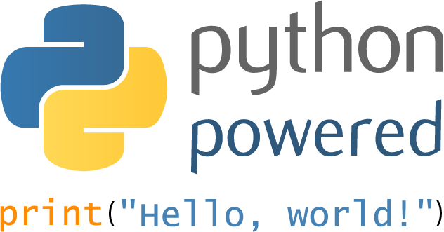
Botnet Lab Framework
IRC Bot
+
Keylogger
DDoS
Spam
Webcam Control

Slide 15

Botnet Wiki
Anatomy
History
Type of attacks
Countermeasures

Slide 16
Q & A
Thank you!
Group 6 – Theme 12
Eduardo Martins (ei11104@fe.up.pt)
João Pedro Dias (ei11137@fe.up.pt)
Jose Pedro Pinto (ei12164@fe.up.pt)
João Sá (ei11142@fe.up.pt)

